Slide 1

NEFS TECHNOLOGY DIVISION
Wednesday 8th February - FX Algorithmic Trading Project

Slide 2
Q and A
We have allocated this time for any questions you may have, r.e project, applications, division, content or anything in general

Slide 3
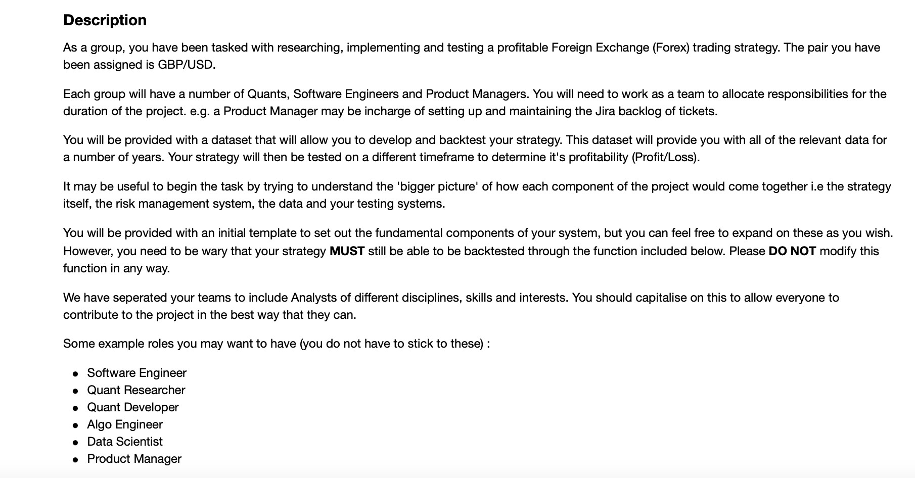
Project Overview
Notes:
Sejal

Slide 4
Project Groups
Team 7
Yimeng Zhang
Maya
Alexandre Dillemann
Jason
Mohamed Suliman
Team 1
Westley Yates
Dami Babatunde
Joshua Kumi-Yeboah
Rebecca Knowles
Tom Wells
Team 2
Stephen Babbs
Chidi
Amirkhan
Neil Somerville
Edwin Cockeye-Brown
Team 3
Kanchi Thakkar
Mustafa Bintube
Ollie Trotman
Isabella Crashaw
Abhay J Nambiar
Team 4
Naina Vaidya
Zhan
Toluwani Babatunde
Monya Abdelazim
JT
Team 5
Enock Oteng Jnr
Shima Nasr Azadani
Om
Lucas Fitz-Gibbon
Storm
Team 6
Amisha Kunde
Maddy Liu
Gadtardi
Chun Him Yeung (Henry)

Slide 5
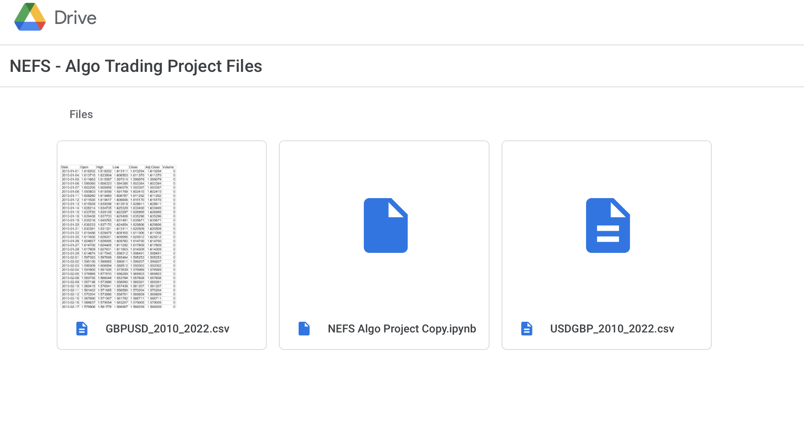
Project Files
https://tinyurl.com/nefs-project

Slide 6
Let the games begin…
Get into your teams
Introduce yourselves, your roles, skill sets
Discuss your initial ideas, when you might want to work on the project etc
Ask questions
Good Luck!

